Slide 1
Fats and oils are looooooong esters
If we start with an alcohol (glycerol or propan-1,2,3-triol) and add ethanoic acid…

Slide 2
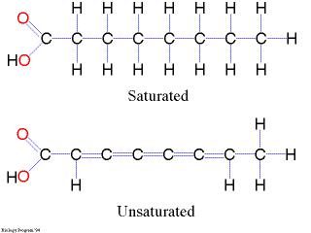
Let’s remember:
Fatty acids are long carboxylic acids.
Called fatty because they can form fats and oils.
Can be saturated or unsaturated

Slide 3
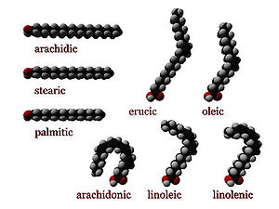
Fatty acids:
Saturated:
Arachidic acid (C20)
Stearic acid (C18)
Palmitic acid (C16)
Unsaturated:
Erucic acid (C22)
Oleic acid(C18)
Arachidonic acid (C20)
Linoleic acid (C18, 2 double bonds)
Linolenic acid (C18, 3 double bonds)

Slide 4
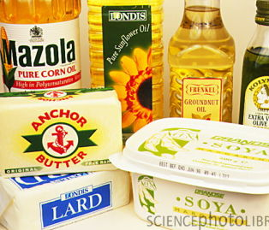
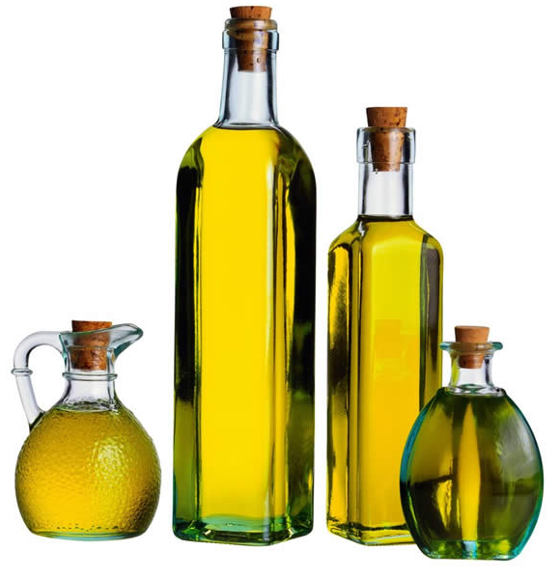
Physical properties of fats and oils
Physical state:
If they are liquid at room temperature (25°C) they are called oils, if they are solid, they are called fats.
Boiling point:
Fats are usually saturated molecules and will have a higher boiling point.
Oils are usually unsaturated molecules.
Solubility:
None of the fats and oils are soluble in water (because they have long carbon chains)

Slide 5
Chemical properties: reactions
The inverse reaction of esterification…
Esters are hydrolyzed either by a base or by an acid to yield a carboxylic acid and an alcohol.
Hydrolysis in acid solution
Saponification in basic solution
+ H₂O +
NaOH or H₃O⁺

Slide 6
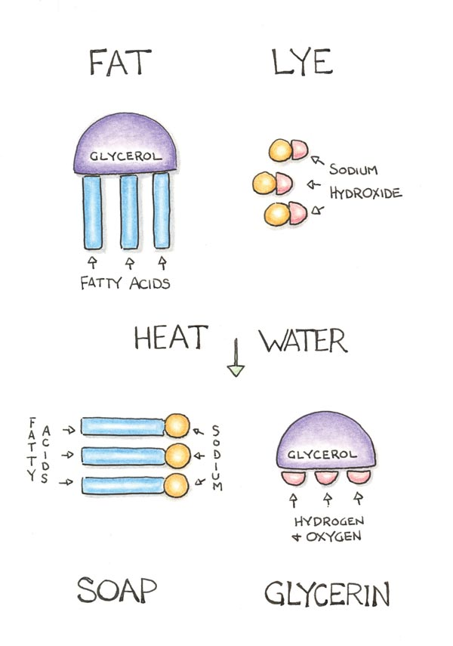
Saponification

